Slide 1




School Management System
Group : 1
MD Shahriar Islam
Mirazul Islam Patawary
MD Abidur Rahman
Student ID: 1000141905
Student ID: 1000141348
Student ID: 1000140960

Slide 2
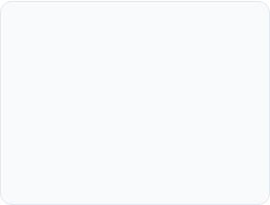
Table of Contents
Introduction & Team Overview
Project Domain & Requirements
Agile Scrum Methodology
User Stories & Task Allocation
Use Case Diagram & System Roles
Entity Relationship Diagram (ERD)
Data Dictionary & Structure
Conclusion & Q&A
GitHub Workflow & Version Control

Slide 3

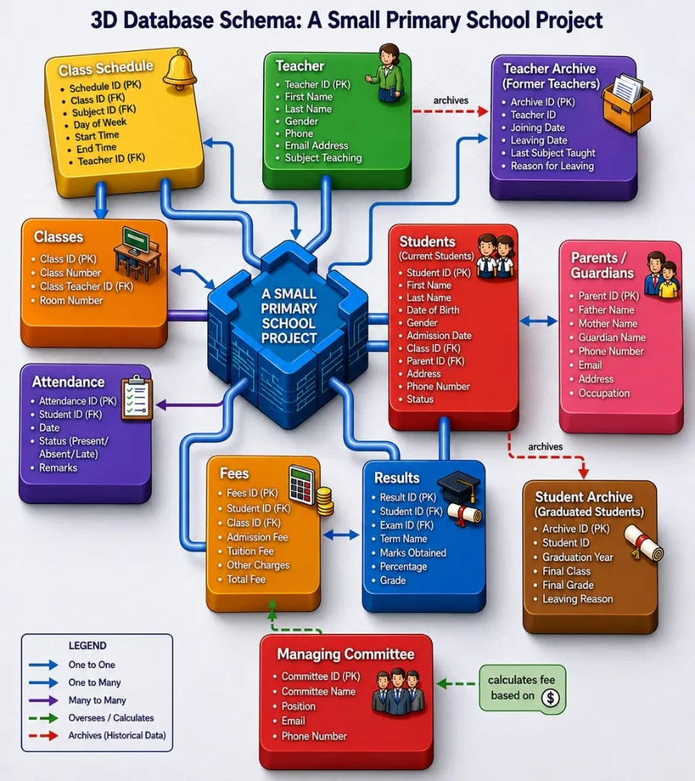
Introduction
System Concept: A simple digital database system designed for a primary school.
Main Goal: Stores and manages all daily school records in one central place instead of paper records.
Core Features: Easily handles student details, teacher profiles, and daily attendance.
Key Operations: Manages class timetables, exam results, and fee collection smoothly.

Slide 4
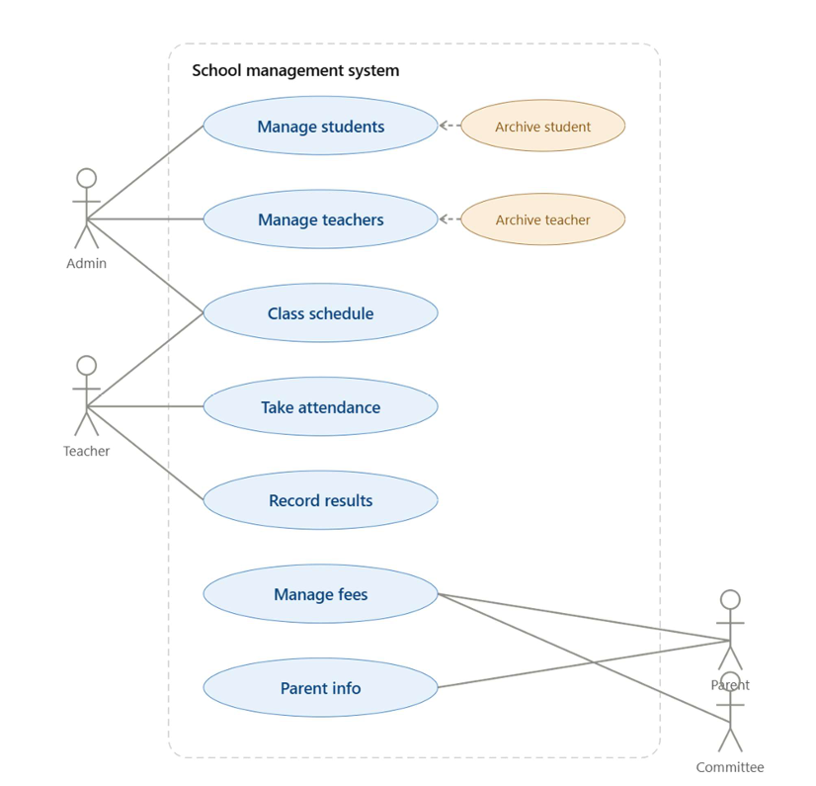
Use Case Diagram
This Use Case Diagram shows who uses the School Management System and what tasks they can perform in it:
Admin: Manages student and teacher information, archives old records, and sets up class schedules.
Teacher: Checks class schedules, takes daily student attendance, and records exam results.
Parent: Views student fee details and updates or checks parent contact information.
👥
Committee: Oversees student fee records and checks parent information for management purposes.

Slide 5
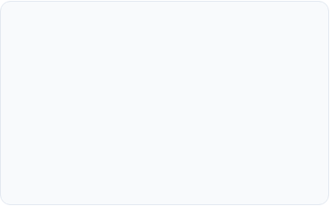
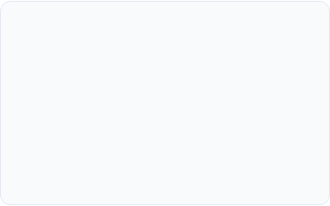
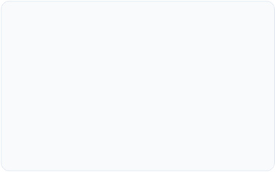


User Stories (Individual Contribution)
It explains who the user is, what they want to do, and why they need it.
Admin Story: (MD Shahriar Islam)
As an Admin, I want to manage student and teacher profiles so that the school records are always up to date.
As an Admin, I want to archive old student and teacher records so that historical data is safely stored.
Teacher Story: (Mirazul Islam Patawary)
As a Teacher, I want to view my class schedule so that I know my daily teaching timetable.
As a Teacher, I want to take daily attendance and record exam results so that student performance is tracked accurately.
Parent & Committee: (MD Abidur Rahman)
As a Parent, I want to check my child's fee details and update parent contact info so that payments and communication stay clear.
As a Committee member, I want to oversee fee management and parent information so that school finances are properly monitored.

Slide 6
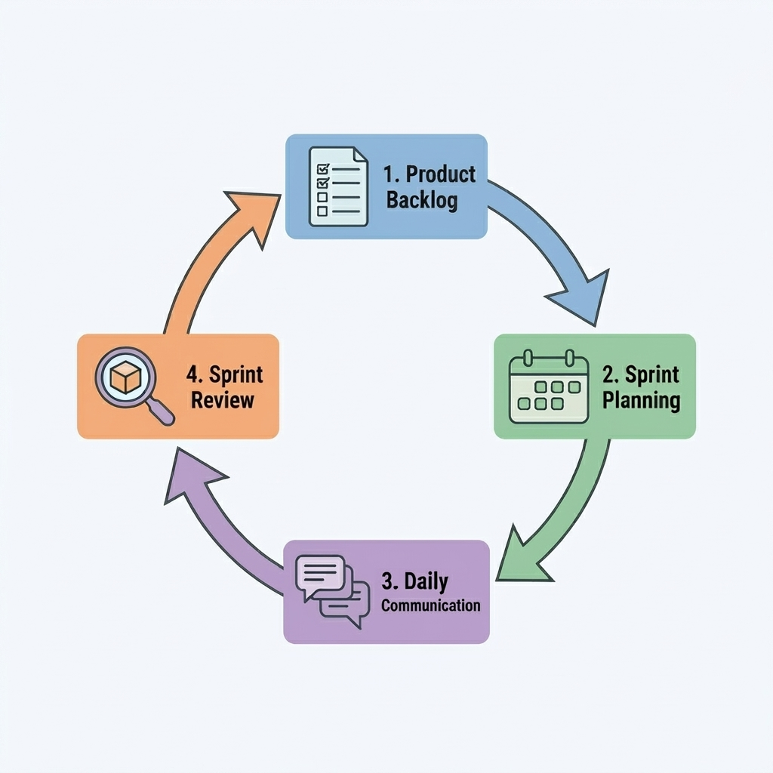

Agile Practice
How We Used Agile in Our Project:
Product Backlog: We created a list of all features needed for our School Management System.
Sprint Planning: In each sprint, our team picked specific tasks to work on.
Daily Communication: We held short daily meetings to check progress and help each other.
Sprint Review: At the end of each sprint, we checked our completed work, fixed errors, and improved our system step-by-step.

Slide 7
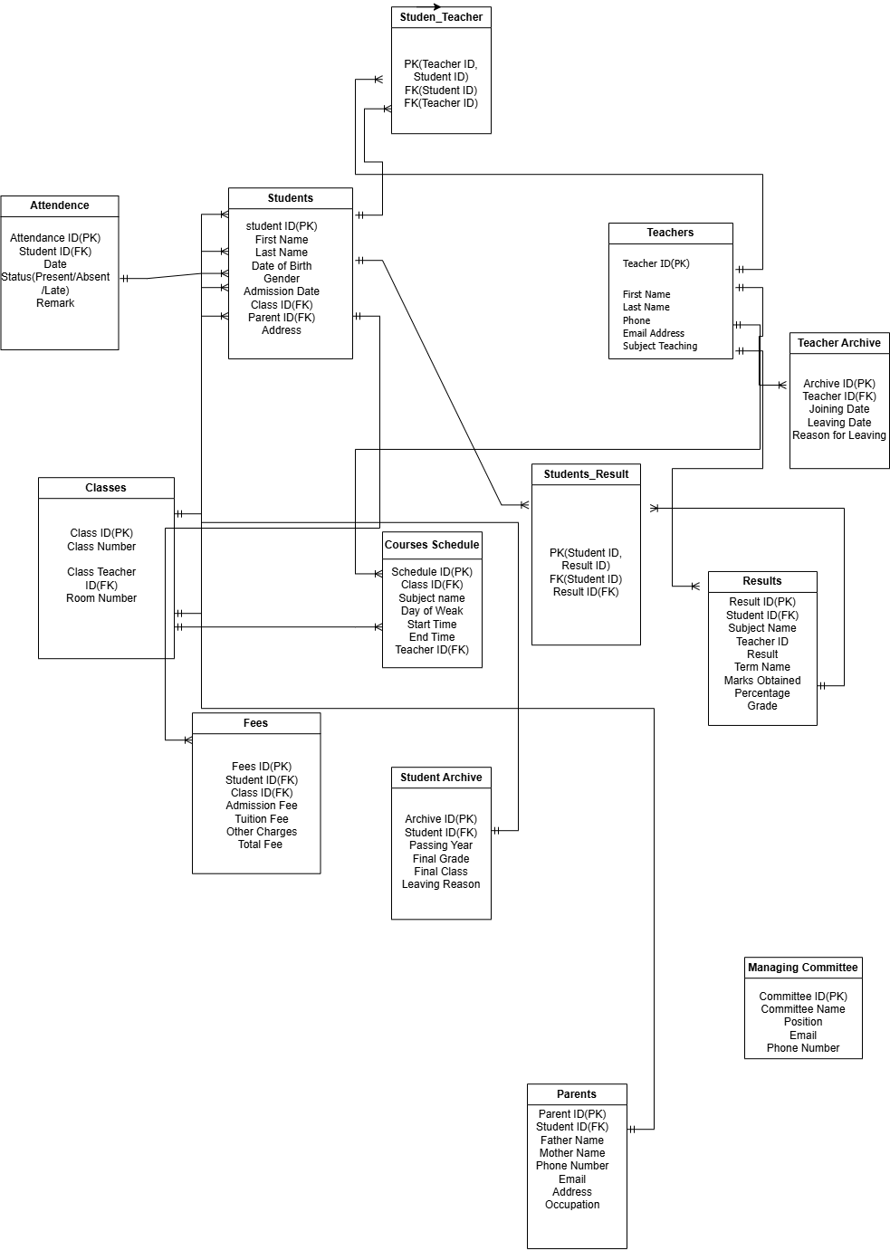
ER Diagram
It shows all the database tables (Entities) for our School Management System and how they connect with each other.
Main Tables & Key Relationships:
Students Table: Central entity that stores personal details (Name, DOB, Address) and connects to Classes and Parents using Foreign Keys (Class ID, Parent ID).
Teachers & Classes: Stores teacher details and links each class to a specific Class Teacher ID.
Course Schedule: Connects classes, subjects, and teachers to manage daily timetables.
Attendance, Fees & Courses: Records daily student attendance status, calculates fee totals, and tracks academic marks and grades.
Student & Teacher Archives: Stores historical records of former students and teachers who have left the school.
Junction Tables: Handles many-to-many relationships between students, teachers, and courses.

Slide 8
Data Dictionary (Individual Contribution)
Table Name | Field Name | Data Type | Key Type | Contributor
Students | Student_ID | Auto Number | Primary Key | MD Shahriar Islam
Teachers | Teacher_ID | Auto Number | Primary Key | MD Shahriar Islam
Attendance | Attendance_ID | Auto Number | Primary Key | Mirazul Islam Patawary
Attendance | Student_ID | Number | Foreign Key | Mirazul Islam Patawary
School_Fees | Fee_ID | Auto Number | Primary Key | MD Abidur Rahman
School_Fees | Amount_Paid | Currency | - | MD Abidur Rahman
Highlighted the 6 main tables out of 12 system entities to keep the slide clean and readable.
Complete documentation and data types for all 12 tables are provided in the main report.

Slide 9


GitHub Usage
1. Main Repository
2. Feature Branches
Created the shared team folder on GitHub to store all code files in one safe place.
Each member used separate code branches to write individual feature updates without conflicts.

Slide 10
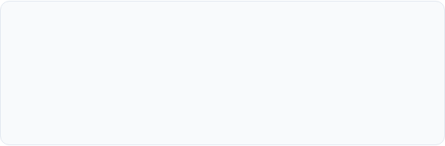
Challenges
Database Table Linking
It was difficult to connect Students and Teacher without duplicating data, but we solved it by using proper Foreign Keys.

Slide 11
Conclusion
Introduction & Domain: Understood the core requirements of a modern School Management System to digitize daily school operations
Agile Scrum Approach: Followed a 4-step Agile cycle (Backlog, Planning, Daily Communication, Review) to keep our development organized.
System Design & Roles: Created Use Case diagrams to define user roles and User Stories to map features accurately.
Database & Workflow: Designed a 12-entity ERD with a clear Data Dictionary for key tables, and managed our code using GitHub version control.

Slide 12
Questions & Answers
Thank you for listening!
We are happy to answer any questions.

Slide 13
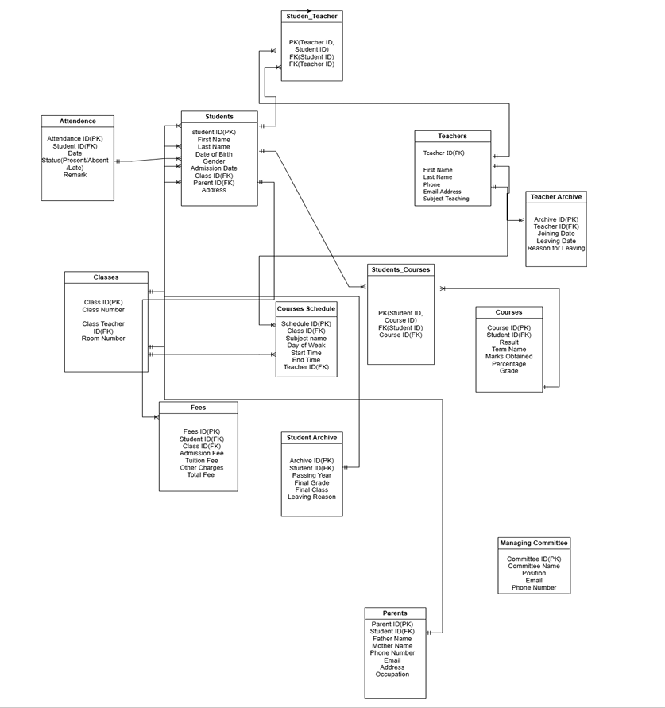
Image Sources
https://online.visual-paradigm.com/repository/images/ec0d979c-50a6-430e-a9c6-8fde247be9b7.png
Source: online.visual-paradigm.com
https://i.ytimg.com/vi/lKdHA2c-dz4/maxresdefault.jpg
Source: www.youtube.com

